Slide 1

An Educational Game for Children
CE301 Individual Capstone Project, Dilovan Panawandi

Slide 2
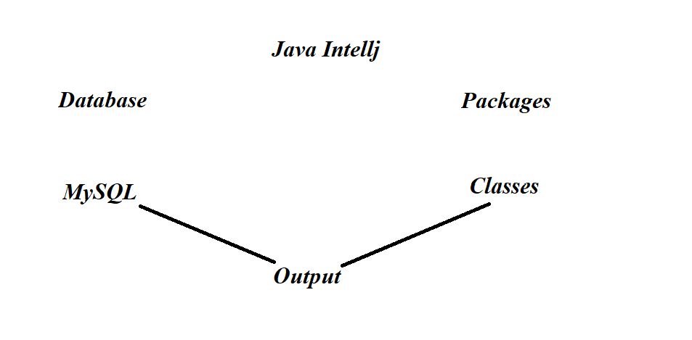
My vision/plan
Java
MySQL
Packages
Classes
Age / level
Three to four minigames
Recording progress
Parents awareness

Slide 3
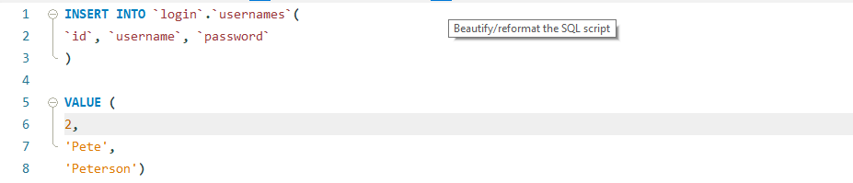
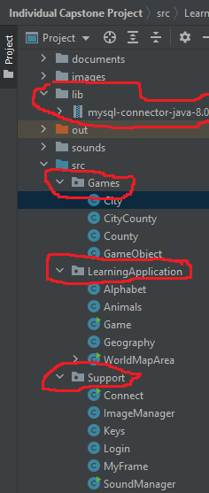
Database & Packages
MySQL
Package
Separation
Connection

Slide 4
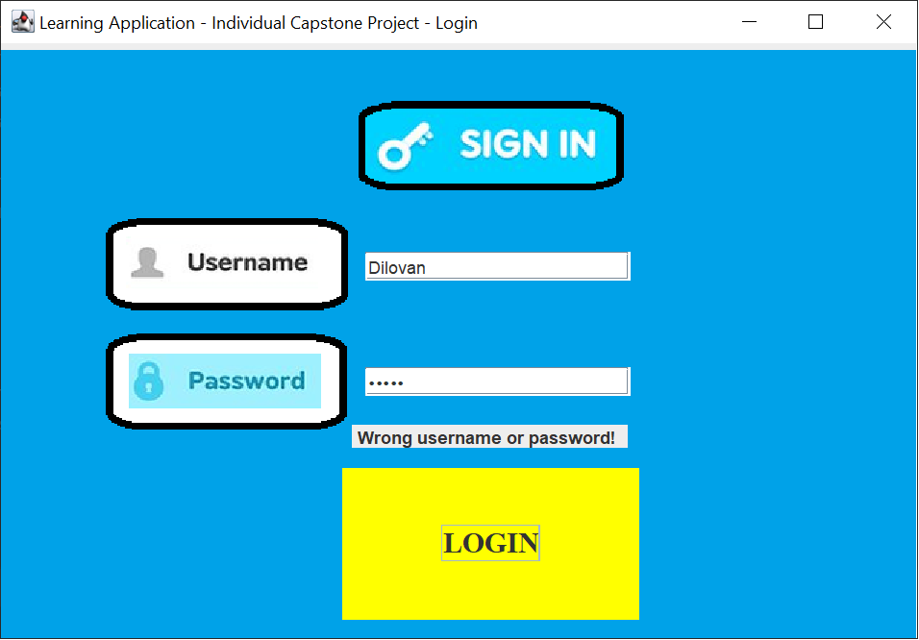
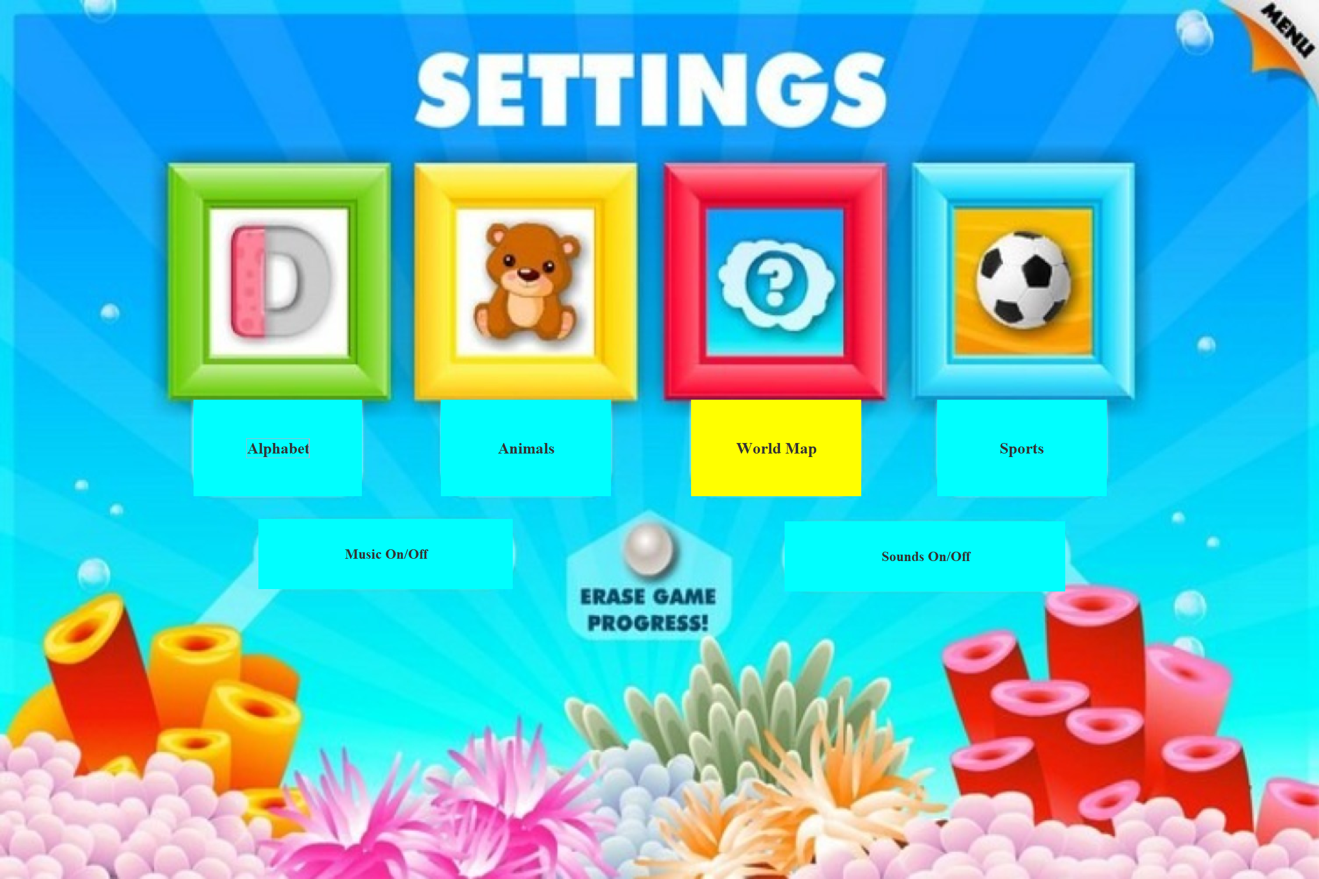
Login page & Home Page
Login class
Frame for home page
Image Manager
Sound Manager
Keys
Support package
Database

Slide 5
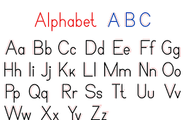
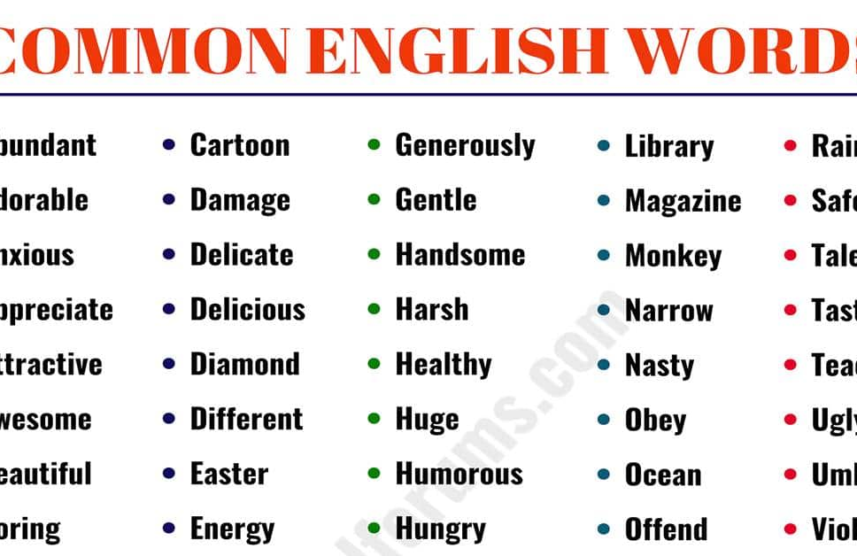
Alphabet
Letters
Words
Sentences
Points
Bonus points

Slide 6
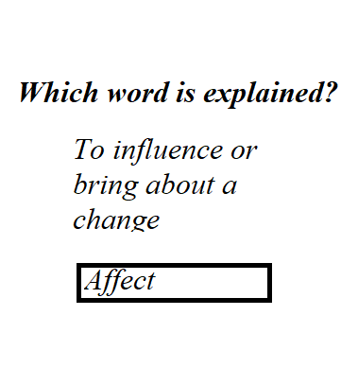
Text field
Learn words
Learn the spelling

Slide 7
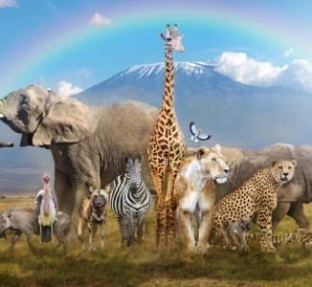
Animals
All types of animals
Breaking it down
Classes for every animal
Bugs & Insects
Facts
Points
Math

Slide 8
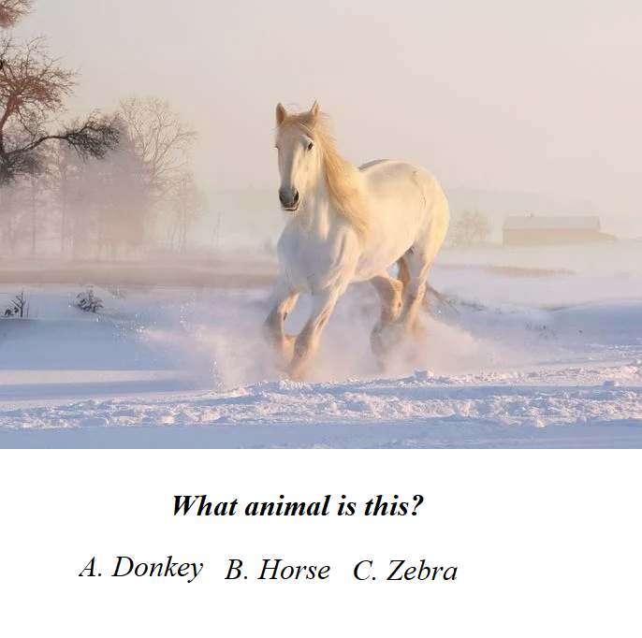

Minigame
Quiz

Slide 9

Geography
Origin
City & County
Expanding
Picking country of own interest
Continents
World Map

Slide 10
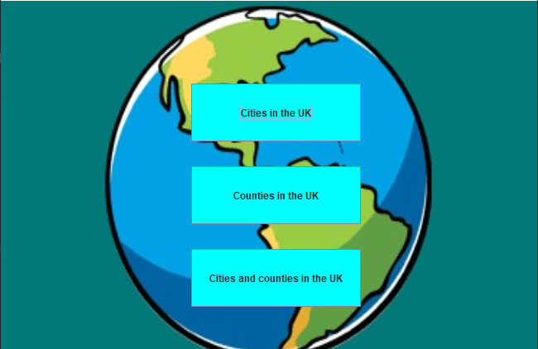
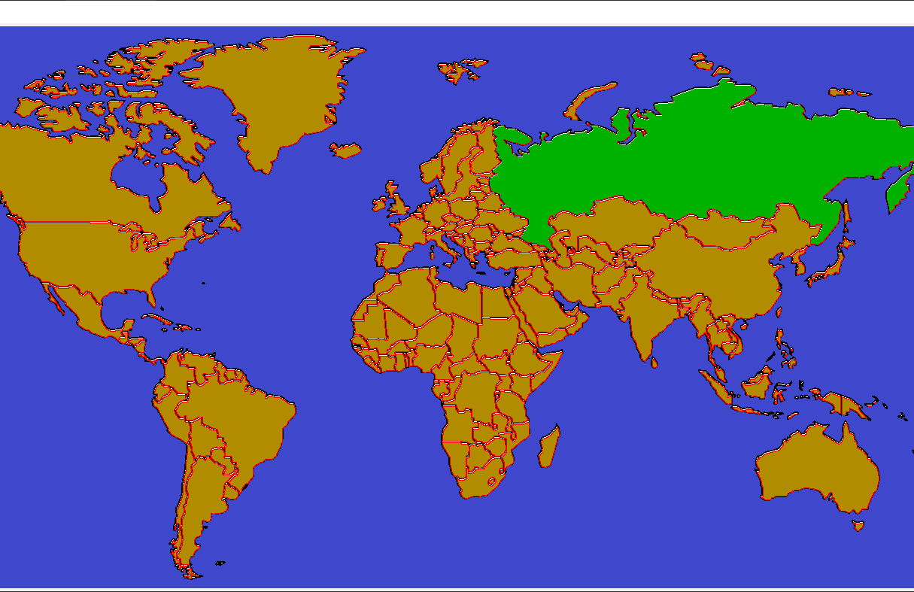
World Map
Difficulty depending on progress/age
Optional minigame
City/County
Flags/Country
Continents

Slide 11

Thank you

